Slide 1
2017 Pantry Client Survey
Montgomery County, PA
Funded by HealthSpark Foundation

Slide 2
2 Prior Surveys
Survey 2014
Survey 2015
January & February
4 pantries participated
201 client surveys collected
Norristown
January & February
8 pantries
653 client surveys collected
3 Norristown 5 outside

Slide 3
2017 Pantry Client Survey
March & April 2017
18 pantries participated
Pantries from all over Montgomery County
1361 client surveys collected

Slide 4
Woo Hoo 1361 !!!

Slide 5
Participating Pantries across Montgomery County & their Coalitions
Pantry | Eastern Montco | InterCounty | Nutrition Coalition | Advocates | Main Line
Ardmore Food Pantry |  |  |  |  | X
Boyertown Multi Services
Catholic Social Services Norristown |  |  |  | X
Seeds of Hope Chelten Dresher | X
Colonial Neighborhood Council Conshohocken
Daily Bread Community Food Pantry Schwenksville |  | X
InterFaith Grace Lutheran Norristwon |  |  |  | X
Hatfield Church of the Brethren |  |  | X
Keystone Opportunity Soudertown |  |  | X
Manna on Main Street Lansdale |  |  | X
Narberth Community Food Bank |  |  |  |  | X
Patrician Society Norristown |  |  |  | X
New Life Presbyterian Glenside | X
Pottstown Cluster |  | X
Salvation Army Norristown |  |  |  | X
Saint James Episcopal Collegeville |  | X
Open Door Ministry Royersford |  | X
Open Link Pennsburg |  | X
Total | 2 | 5 | 3 | 4 | 2

Slide 6
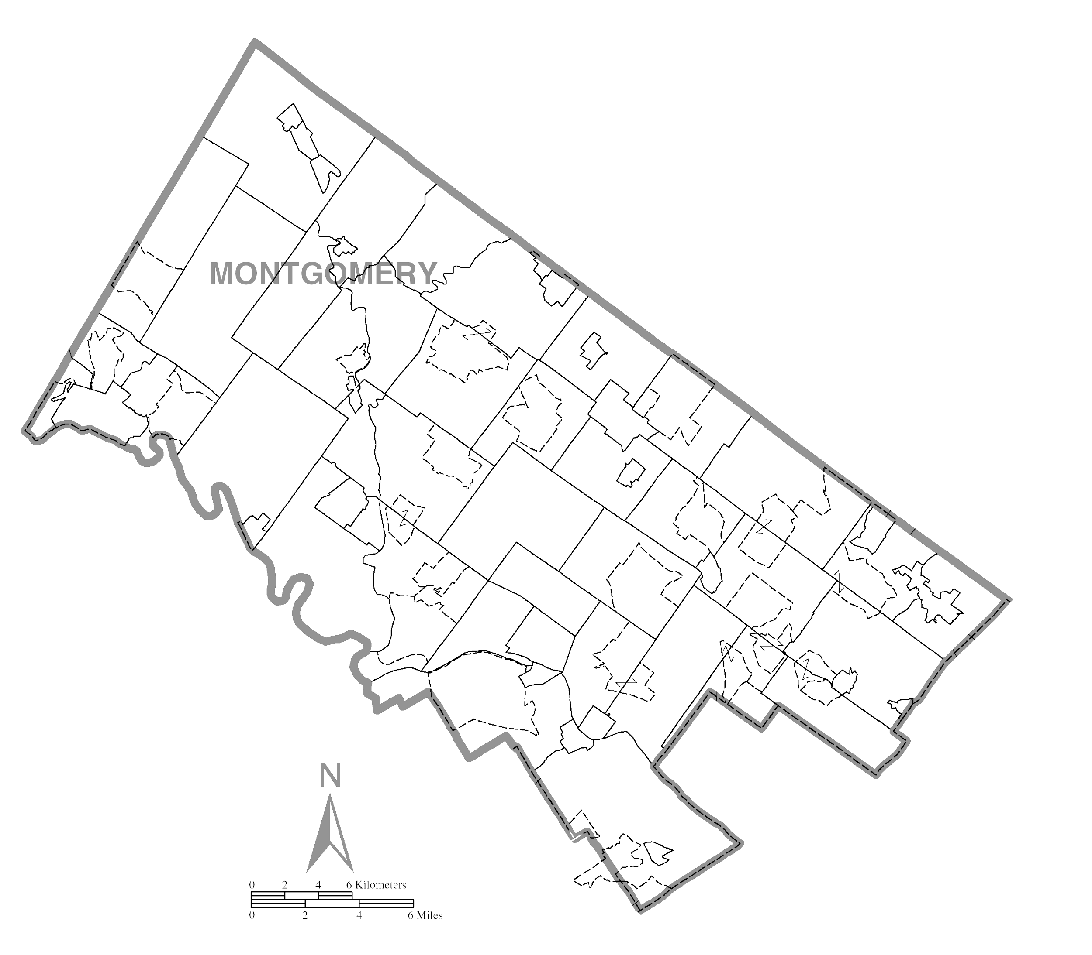
Food Pantry Locations
18
Ardmore Food Pantry
Boyertown Multi Services
Catholic Social Services
Seeds of Hope Chelten
Colonial Neighborhood Council
Daily Bread Community Food Pantry
Interfaith at Grace Lutheran Church
Hatfield Church Of The Brethren
Keystone Opportunity Center
Manna On Main Street
Narberth Community Food Bank
Patrician Society
New Life Presbyterian Church
Pottstown Cluster
Salvation Army, Norristown
Saint James Episcopal
The Open Door Ministry
The Open Link
2
9
8
14
10
6
17
16
4
15
3
7
13
12
5
1
11

Slide 7
The Process
Clients who participated entered in a drawing for a $50 Gift card at most of the pantries
Pantry distributed surveys for a month in order to reach as many clients as possible
Anonymous & Voluntary for clients
Survey also available in Spanish and Arabic
Several pantries used student volunteers to assist
Aimed for 20% of client participation

Slide 8
Initial Findings from County Wide Stats
Average age is 52
73% Female
58% White 27% Black or African American 6% Hispanic or Latino
47% High School Diploma 15% Tech or Vocational 30% have 2 or 4 college degree
468 people answered they work full-time
55% receive SNAP
60% of those who receive SNAP say it lasts 2 weeks or less
177 people responded not on SNAP but interested in help to apply (348 said no thanks)
73% are registered voters
93% rated the pantry Very Good or Good 80% said Very Good or Good at serving dietary needs
72% use only this pantry 23% use 2 pantries
80% said with pantry, they are able to take care of monthly food need s

Slide 9
Areas of Instability
Housing
Health
Of 458 responses that “in last year”
24% moved to find work
44% moved to find affordable housing
19% evicted or received eviction notice
7% put home up for sale because could not afford mortgage
6% lost home due to foreclosure
429 Adults without Health Insurance
274 people, due to cost -put off filling a prescription
334 people, due to cost -put off going to doctor
535 people, due to cost -put off going to dentist
633 people -High Blood Pressure
519 people -overweight

Slide 10
Comparison of 3 years of survey
All percent are based on number of responses on particular question and not on number of surveys collected. Percent is rounded off to the closest whole number.
Total Surveys collected | 2014 201 | 2015 653 | 2017 1361
Female | 66% | 75% | 73%
Black | 38% | 35% | 27%
Hispanic | 15% | 6% | 6%
White | 40% | 55% | 58%
Average Age | 46 | 49.5 | 51.7
HS grad or (Tech ) + | 62% | 50% | 61%
2 or 4 yr college grad > | 11% | 17% | 30%
Registered Voters | 70% | 75% | 73%
Own Home | 14% | 23% | 20%
Diabetes | 28% | 24% | 35%
HBP |  | 54% | 54%
Veterans HH | 14% | 12% | 8%
With Pantry meet food needs | 71% |  | 80%
SNAP receive | 64% | 60% | 55%
Last 2 weeks or < | 51% | 65% | 60%
Individuals reporting they work full time | 44 of 201 | 104 of 653 | 468 of 1361

Slide 11
Take-Aways
Clients were very willing to participate in survey
With pantries help, most clients are able to feed their families for the month
Clients are very satisfied with their pantries
Pantries are in a good position to provide, to advocate for and/or to lead clients to the resources they need to stabilize their situations.

Slide 12
Reports from 2017 Survey
County Wide Report
3 Coalition Reports: Nutrition, Intercounty & Advocates Against Hunger
Individual Pantry Reports

Slide 13
57.6% White 72.7% Female 51.69 Average Age 2017 survey

