Slide 1
Survey Says!
Greater Philadelphia Food Pantry Coordinator Survey

Slide 2
background

Slide 3
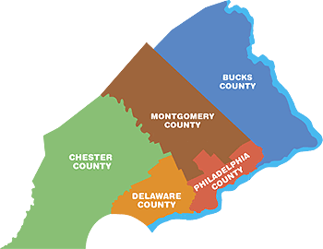
Greater Philadelphia Pantry Coordinator Survey
Partnership between Coalition Against Hunger, Share, Philabundance, and suburban group
Over 700 pantries in
the five county area

Slide 4
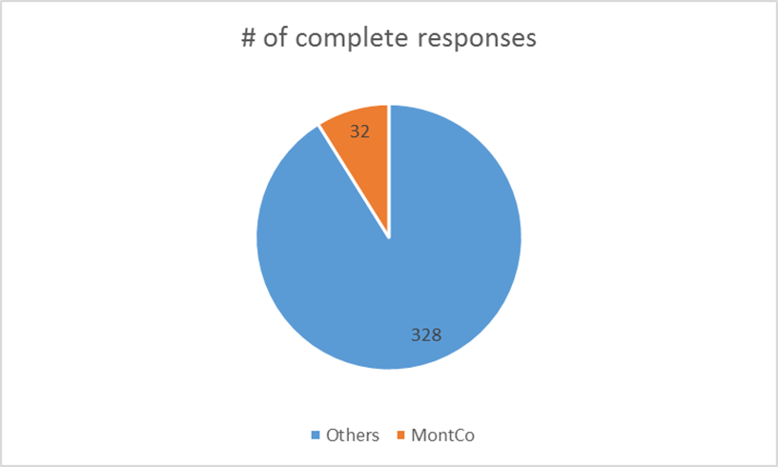

Slide 5
purpose

Slide 6
Shared metrics
Up-to-date pantry info
Understanding needs
of pantry coordinators

Slide 7
results

Slide 8
Running Out of Food
56% of Montgomery County pantries never run out of food vs. 30% overall
0% of Montgomery County pantries run out of food often/always vs. 18% overall

Slide 9
87.5% of pantries have healthy foods in MontCo

Slide 10
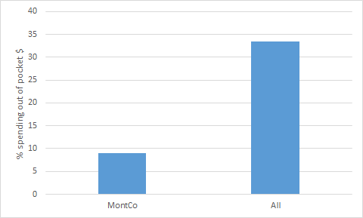
Pantry Sustainability

Slide 11
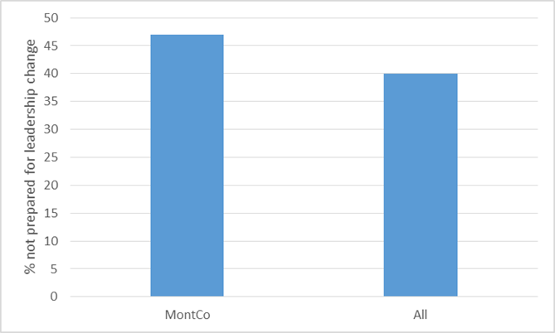
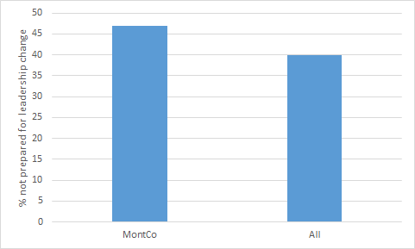

Slide 12
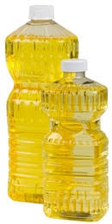
Top 5 Requested Food Types
Survey Says...
Notes:
75-80% of pantries wanted these five items

Slide 13
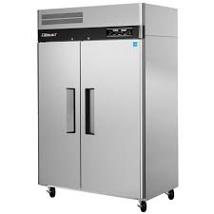
Top 3 Requested Non-Food Items
Survey Says...
Notes:
Grocery bags (62.5%), freezers/fridges (44%), language assistance (38%

Slide 14
Partnerships
~50% interested in:
attending training together
fundraising together
speaking to legislators together

Slide 15
what’s next?

Slide 16
Pantry Map Update - Summer 2017
Pantry Coordinator Survey Blueprint - Fall 2017
Recommendations for different stakeholder groups

